Slide 1

Tentative Title: Integrative Trajectory Forecasting for Autonomous Vehicles in Mixed Traffic Environments
Department of Computer Science & Engineering
Supervised By:
Md Rakibul Haque
Lecturer,
Dept. of Computer Science & Engineering, RUET.
Presented By:
Md. Nazmul Hossain ID : 1803170

Slide 2
Topic Outline
Introduction
Literature Review
Challenges
Objectives
Methodology
Dataset Details
Results
Conclusion
Future Work
References

Slide 3
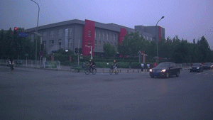
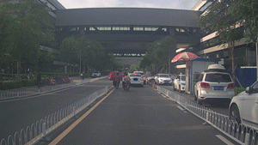
Introduction
Trajectory refers to a path that a vehicle moves through space over time.
For of an autonomous vehicle, trajectory not only the route but also it’s motion—speed, acceleration, and direction etc.
Fig – 1: Some trajectories of various vehicle [5]

Slide 4

Introduction (CONT’D)
Mixed traffic environment consists of different types of road users, such as pedestrians, bicycles, motorcycles, cars, and buses, share the same space and interact with each other.
Fig – 2: Mixed Traffic Environment [1]

Slide 5
Literature Review
TrafficPredict: Trajectory Prediction for Heterogeneous Traffic-Agents [2]
Performances:
Using previous state-of-the-art approaches in accuracy for trajectory prediction in heterogeneous traffic
Offer real-time performance without assumptions about traffic conditions or the number of agents.
Limitations:
The accuracy varies with traffic conditions and the historical data available.
Future improvements will consider additional constraints such as lane directions, traffic signals, and rules.

Slide 6
Literature Review (CONT’D)
Interactive Trajectory Prediction for Autonomous Driving via
Recurrent Meta Program Induction Network [3]
Performances :
Use traditional kernel methods in predicting the trajectory of human-driven cars, achieving lower mean error rates in trajectory prediction for both longitudinal and lateral directions.
Limitations:
Future developments are needed for a more advanced generator and observer structure to further reduce prediction errors and to extend the framework to more general scenarios, such as turns at intersections and highway merging.

Slide 7
Literature Review (CONT’D)
Probabilistic Trajectory Prediction for Autonomous Vehicles with Attentive Recurrent Neural Process [4]
Performances :
The Attentive Recurrent Neural Process (ARNP) proposed in the paper effectively captures sequential information traffic scenarios.
ARNP outperforms several previous approaches in terms of prediction accuracy, variance, and probability expressiveness by predicting an explicit distribution.
Limitations:
Future developments are needed for better recognize and adapt to poorly understood traffic.

Slide 8
Challenges
Work on Urban Areas
Deals with Mixed Traffic Agents
Reduce Prediction Error

Slide 9
Objectives
Deals with mixed traffic environment consists of various cars, bicycles, bikes, buses, pedestrians, traffic lights etc in an urban areas.
Also increasing the accuracy of the model is an obligatory part of my work.

Slide 10
Methodology
4D Graph Generation
Apply LSTM Based Model
LSTM Model Train with Dataset
Instance Layer
Category Layer
Instance Layer
Category Layer
Prediction Generation
Reduce Prediction Error
Model Evaluation & Refinement

Slide 11
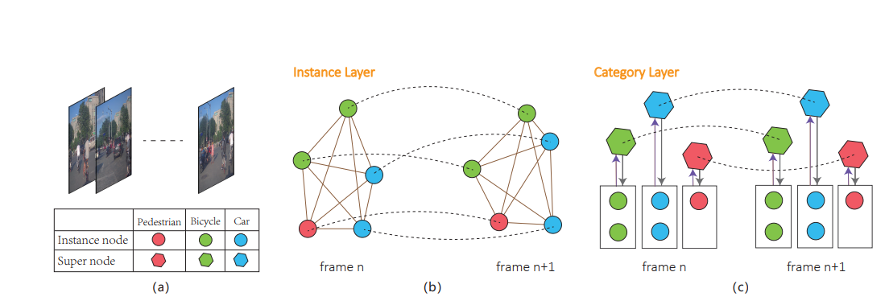
Methodology (CONT’D)
4D Graph Generation
Fig – 3: (a) Sample image frames of various traffic agents, (b) Instance layer graph between two frames, (c) Category layer supernode creation and graph. [5]

Slide 12
Methodology (CONT’D)
Instance & Category Layer
Frame (t)
Frame (t+1)
Instance Layer
Category Layer
Instance Layer
Category Layer

Slide 13
Dataset Details
Dataset Name: ApolloScape Dataset
It contains 53 file, each file for 1 min sequence with 2 fps (frame per second) rate.
Attribute | Description
Frame_id | It indicates a unique frame of a video stream which is captured on 2fps rate.
Object_id | It indicates the unique object.
Object_type | It indicates the type of an object such as vehicle, bicycle, pedestrian or other.
Position_x,y,z | The position x,y,z indicates the location of an object in world coordinate system.
Object_length | It indicates the length of an object.
Object_width | It indicates the width of an object.
Object_height | It indicates the height of an object.
Heading | The heading value is the steering radian with respect to the direction of the object.
[5]

Slide 14
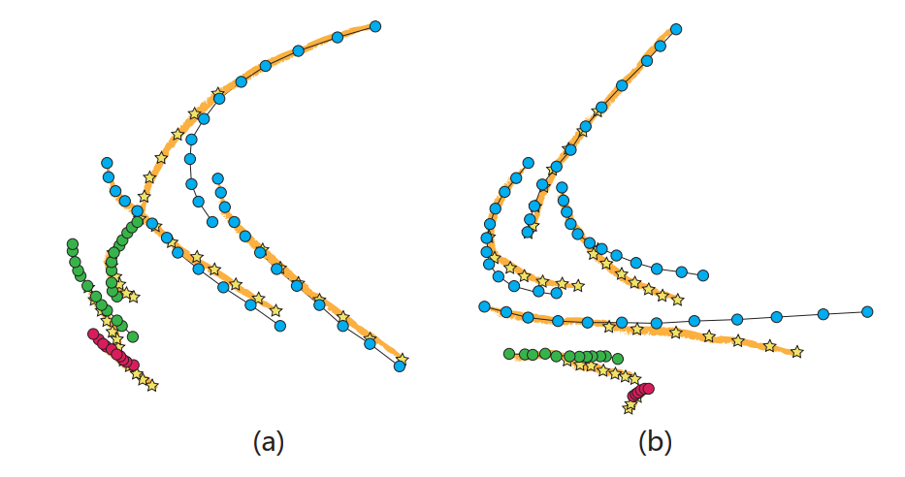
Results
Here, I was implemented the existing algorithm and comparison with the base paper results.
Instance | Paper ADE | My ADE | Paper FDE | My FDE
Pedestrian | 0.091 | 0.088 | 0.150 | 0.132
Bicycle | 0.083 | 0.075 | 0.139 | 0.115
Vehicle | 0.080 | 0.090 | 0.131 | 0.153
Total | 0.085 | 0.084 | 0.141 | 0.133
Fig - 4 : Displacement error between ground truth and predicted (Yellow line) trajectories [2]

Slide 15
Conclusion
Collected the Dataset from ApolloScape Auto Authority
Understood the all training and testing data file
Implement the existing algorithm and analyze the results

Slide 16
Future Work
Apply LSTM Architecture to Train with the Dataset for mixed traffic agents
Evaluate Model and Calculate Prediction Error
Reduce Prediction Error

Slide 17
References
[1] https://c8.alamy.com/comp/2GDM3KX/isometric-city-crossroad-with-cars-road-intersection-traffic-jam-urban-downtown-street-with-transport-and-people-vector-illustration-public-and-private-transport-in-residential-area-2GDM3KX.jpg
[2] Yuexin Ma, Xinge Zhu, Sibo Zhang, Ruigang Yang, Wenping Wang, Dinesh Manocha4
[3] Chiyu Dong, Yilun Chen and John M. Dolan
[4] Jiacheng Zhu, Shenghao Qin, Wenshuo Wang, Member, IEEE, and Ding Zhao
[5] https://apolloscape.auto/trajectory.html

Slide 18
Thank You

Slide 19
Q/A

